Slide 1

Intruder Detection IoT System
Deepan Raj Dulal

Slide 2
Overview
Our project aimed to create an Intruder Detection IoT system. We combined components like the PIR sensor, LED, buzzer, and camera module into one system using a Raspberry Pi and Python code. This integration allowed us to develop a functional and effective solution for detecting intruders.

Slide 3
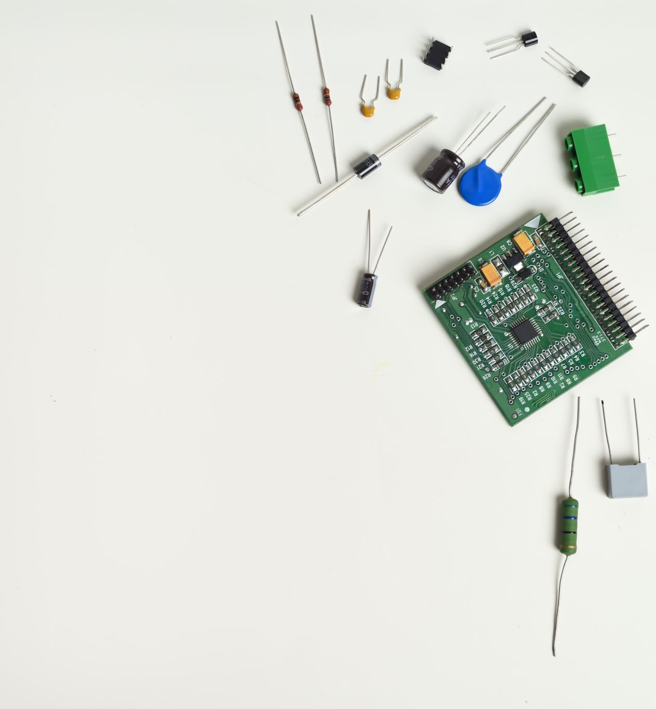
Hardware Components
The hardware components used in this projects were:
Raspberry Pi
Passive Infrared (PIR) Sensor
Camera Module
Led Light
Buzzer

Slide 4
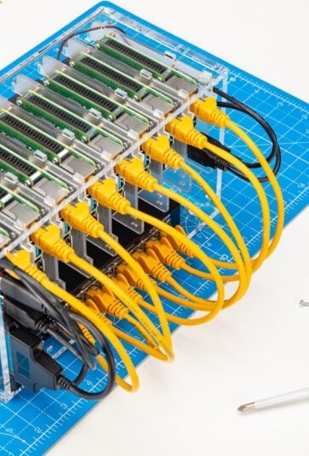
Raspberry Pi
What are they?
Low cost “pocket computers” mockingly named after the rest of companies who went with fruit themes, and the “pi” stands for Python.
Made to promote computer science in youth and hobbyists
How they work
Same as a normal computer! Just different architecture (ARM)
Entirely open source, able to customize everything
What they’re used for
DIY projects, retro consoles, learning, servers, audio streaming (music), robotics, etc.

Slide 5

Passive Infrared Sensor(PIR)
Motion sensor that detects infrared emitted by objects within its field of view
Based on the principle that all objects above absolute zero temperature emits heat in the form of infrared radiation
Motion causes a change in infrared radiation detected, causing the sensor to send a signal.
Consists of a Fresnel lens that can change the breadth, range, and sensing pattern
Plano-convex lens helps increase the range and sensitivity of the sensor.
Used in security systems, light controls, or any application that’s motion based on people entering

Slide 6
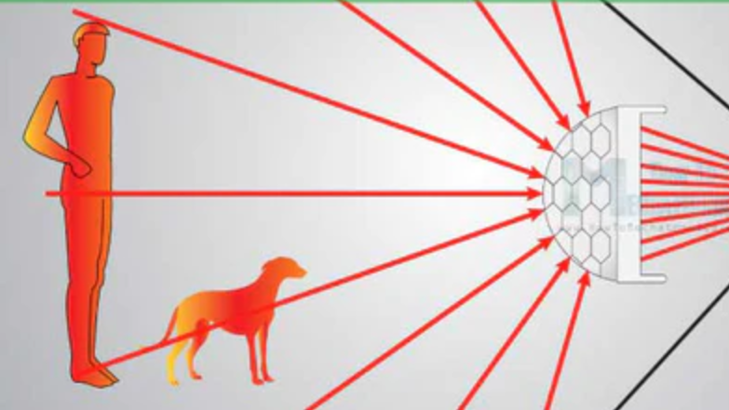

Slide 7
Constraints of the PIR sensor
Have shorter range than a lot of applications may want
Hot temperatures can make it less effective
Not very effective outside
Doesn’t like being around other devices

Slide 8

Camera Module
Compact, high quality camera accessory that integrates flawlessly with the Raspberry Pi.
Easy to attach to Raspberry Pi’s dedicated camera port.
Captures still images and video footage.
Captures light passing through the lens and maps it to a pixel array
Pixel array has millions of pixels that have a colored film over it to grasp the light intensity and the color of the light hitting it
Raw data from the pixels are converted into a digital value which is passed back to the board to process
After the board gets the digital info it pieces everything together into a normal png that we get to open
Controlled by users using python scripts.

Slide 9

LED Light
Semi-conductor device that emits light when an electric current passes through it.
Small, efficient, and durable lights used as indicators, display and electronic components.
Variety of color, sizes and brightness depending on the current flowing through them.
Commonly found in everyday devices like smartphones, televisions.

Slide 10
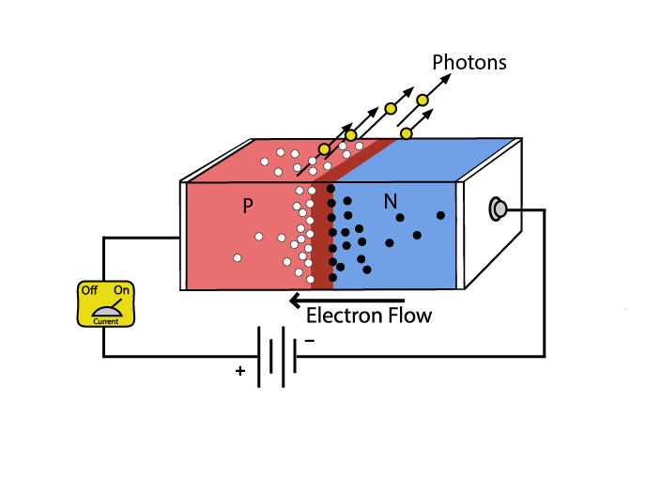
LED
Voltage goes in, electrons move and fit in valence slot, create photons, photons go brr…ONTO THE NEXT

Slide 11
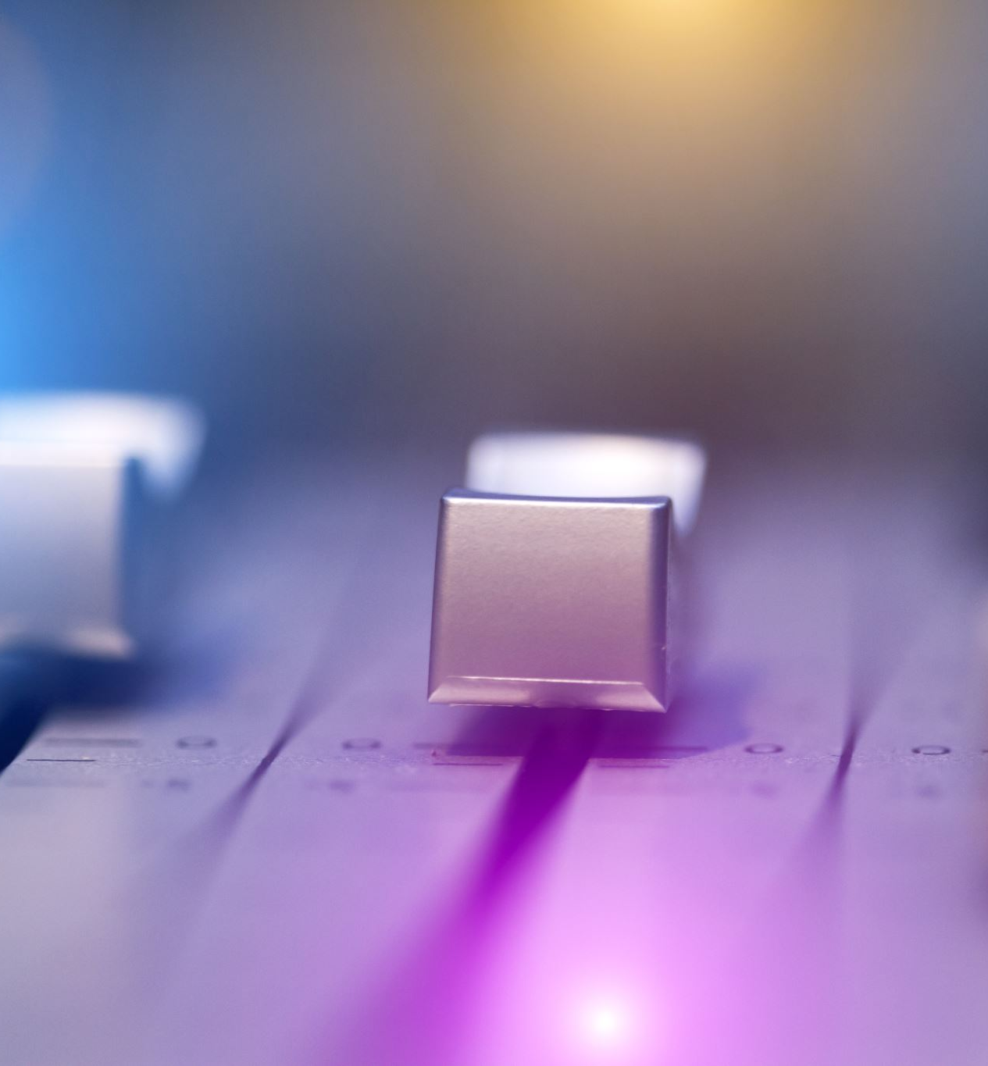
Buzzer
Electronic device that produces sound when electric current passes through it.
Can vary in frequency and intensity depending on the design of the buzzer.
Makes a sound based on the frequency of the signal which also changes the speed of the vibration
Creates sound by vibrating a disk when voltage is applied
(disk is ceramic with a metal exterior)
Sound propagation influenced by the buzzer’s housing
Commonly used in alarm systems.

Slide 12
Integration
The PIR sensor serves as our primary sensory component, tasked with detecting motion and relaying signals to the Raspberry Pi. Upon detection, motor components are promptly activated, prompting the buzzer to emit an alarm, the LED to illuminate, and the camera to capture an image of the area.
These integral components are controlled through a Python script to interface with the Raspberry Pi's input/output channels. Within this script, each component is assigned specific pins, and a loop structure causes their activation in response to input signals from the PIR sensor. This integration facilitates the smooth operation of our system, ensuring an effective response to detected motion events.

Slide 13
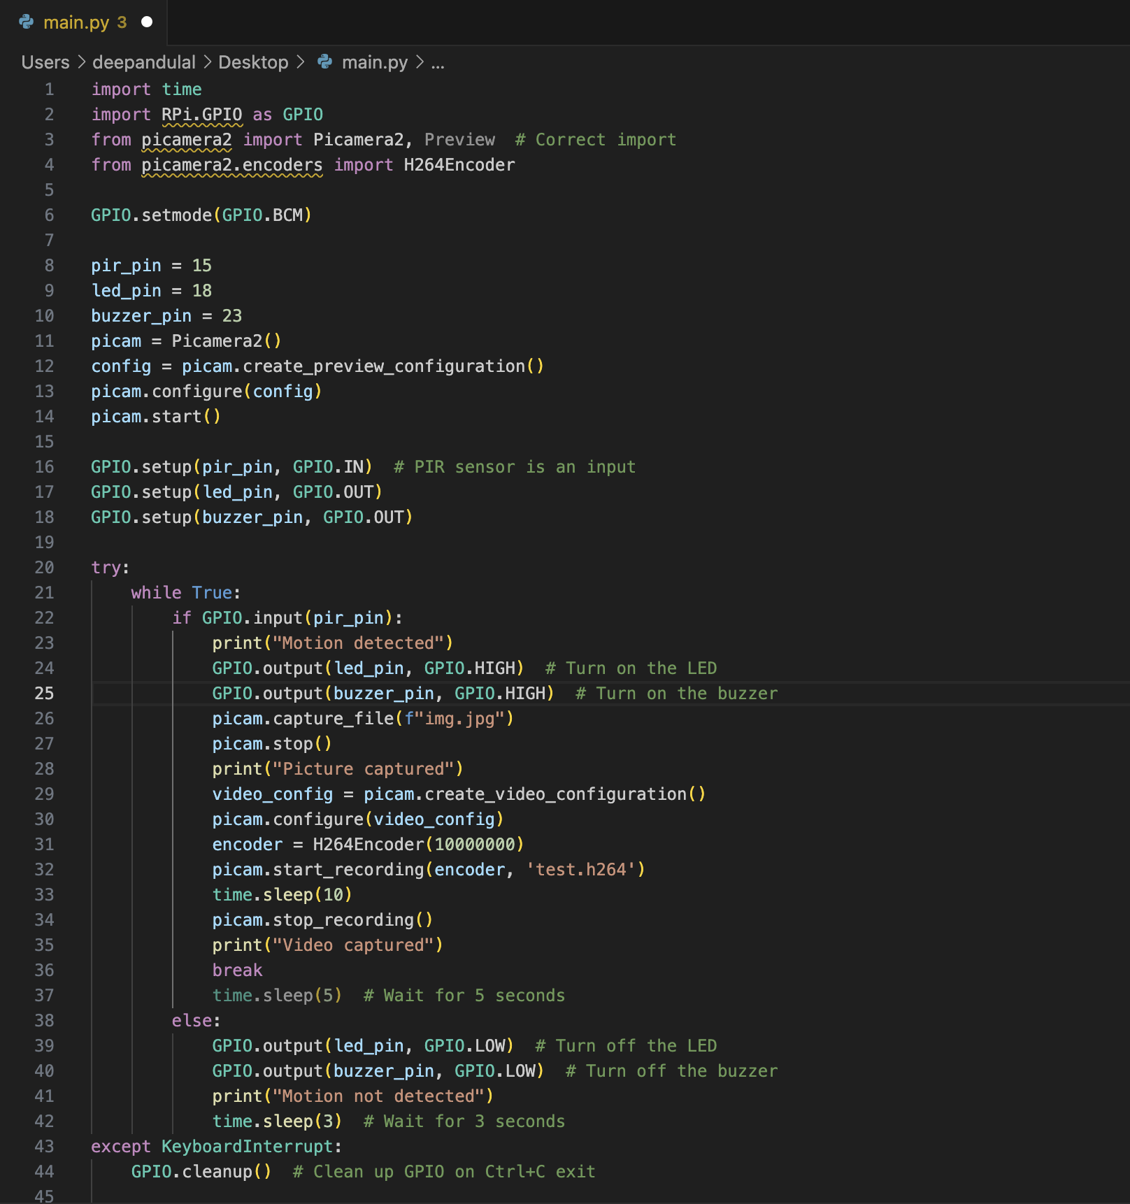
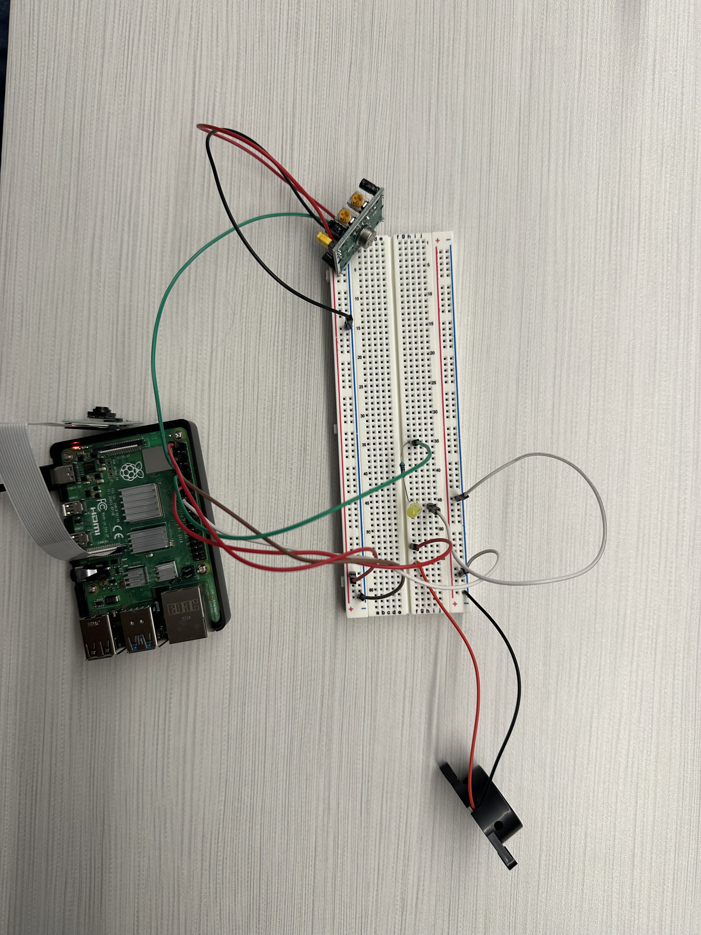

Slide 14
Result
After carefully integrating the circuit and customizing our Python script, we successfully developed a system that promptly detects motion and triggers a response through our components. The terminal also provides a motion detection prompt, refreshing every two seconds without motion and lasting four seconds upon detection, effectively signaling through the output components.

Slide 15
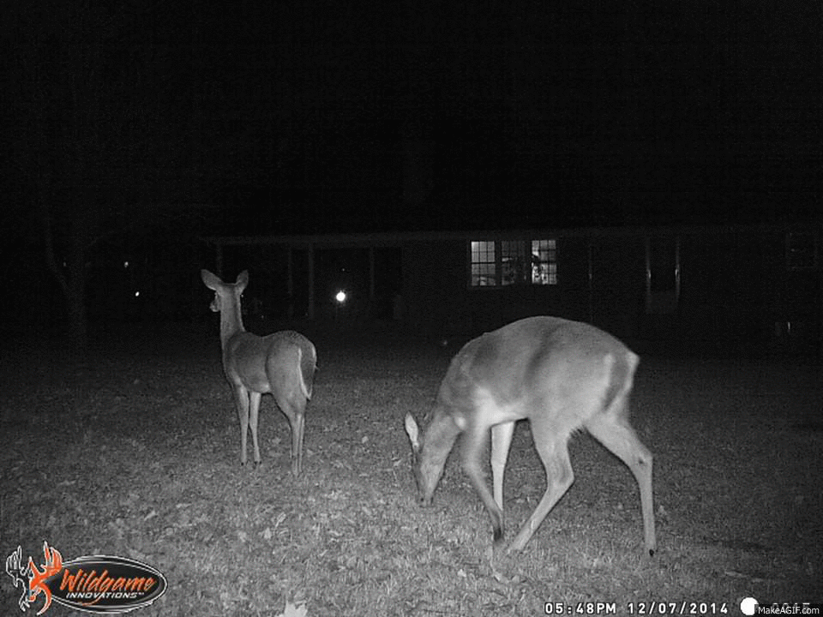
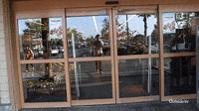
Some Real Applications
Monitoring wildlife (trail cams)
Pet doors and feeders
Smart-homes
Front doors in supermarkets/stores
Patient monitoring
Smart cars (auto-driving features)

Slide 16
Conclusion
In conclusion, our project successfully achieved the development of an Intruder Detection IoT system by seamlessly integrating key components like the PIR sensor, LED, buzzer, and camera module. Leveraging the Raspberry Pi platform and Python programming, we created a reliable solution for detecting intruders. This project not only showcases the effectiveness of our approach but also highlights the practical applications of such systems in real-world scenarios, ranging from home security to commercial surveillance.

